Slide 1
The Applet Class

Slide 2
Introduction to Applets
A Java program that runs inside a browser
We embed applet in an HTML page using the <APPLET> tag
Introduces interactivity in static web pages
Applets run inside a browser (executed at client side) & save server roundtrip, thereby reducing traffic
Applets do not begin execution at main( ).
An applet begins execution when the name of its class is passed to an applet viewer or to a network browser.
When a user views an HTML page that contains an applet, the code for the applet is downloaded to the user's machine.
A JVM is required to view an applet. The JVM can be either a plug-in of the Web browser or a separate runtime environment.
The JVM on the user's machine creates an instance of the applet class and invokes various methods during the applet's lifetime.

Slide 3
Introduction to Applets
There are two ways you can run an applet:
Executing the applet within a Java-compatible browser.
Write the code in a .java file, write the html code in a .html file and open the file .html in a browser, .class files should be in same folder.
When the browser finds the class file, it loads it over the network, if necessary, onto the computer the browser is running on.
The browser then creates an instance of the class.
If you include an applet twice in one page, the browser loads the class file once and creates two instances of the class.

Slide 4
Using appletviewer
Appletviewer is a test utility available in JDK for testing applets if we do not have a java-enabled browser
<applet> tag has attributes like:
Code : Represents the .class file of the Applet
Height : Represents the height of the Applet
Width : Represents the width of the Applet
Using an applet viewer, such as the standard SDK tool, appletviewer. An applet viewer executes your applet in a window.
appletviewer test.html after compiling the program.

Slide 5
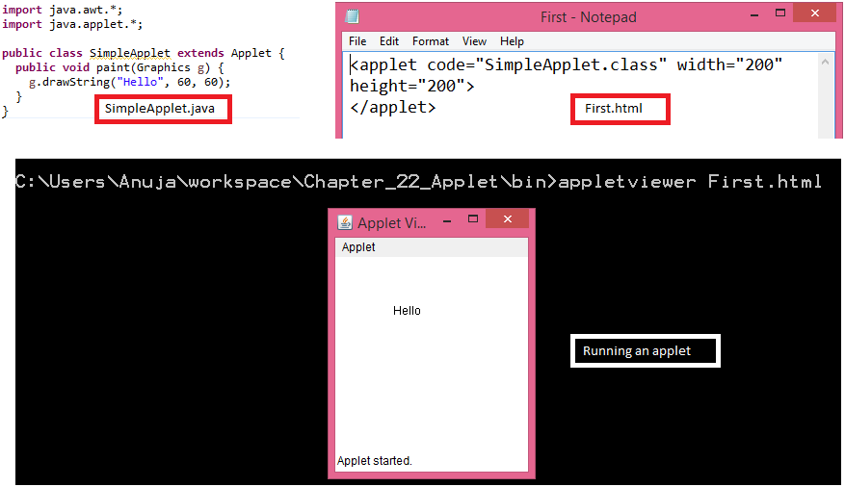
Using appletviewer

Slide 6
The Applet Class
Provides methods to load and display images, and methods that load and play the audio clips.
Applet extends the AWT class Panel.
In turn, Panel extends Container, which extends Component.
These classes provide support for the Java’s window-based, graphical interface.
Applet Architecture
Event- driven : waits for an event to occur. AWT notifies an applet about an event by calling an event handler that has been provided by the applet.
The applet takes an appropriate action and then quickly returns the control to the AWT.

Slide 7
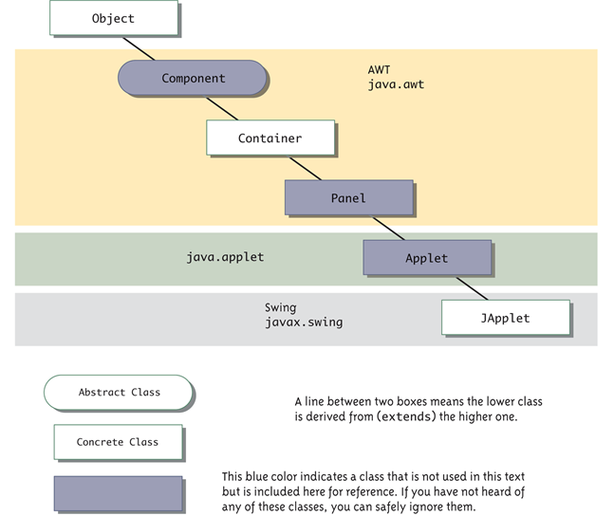
Applet Architecture

Slide 8
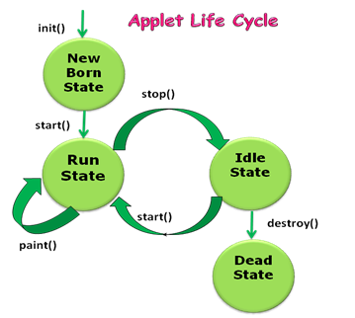
Applet Life Cycle
init( ), start( ), stop( ) and destroy( )
init( )
Called exactly once in an applet’s life.
Called when applet is first loaded, which is after object creation, e.g., when the browser visits the web page for the first time.
Used to read applet parameters, start downloading any other images or media files, etc.

Slide 9
Applet Life Cycle
start( )
Called at least once.
Called when an applet is started or restarted, i.e., whenever the browser visits the web page.
stop( )
Called at least once.
Called when the browser leaves the web page.
destroy( )
Called exactly once.
Called when the browser unloads the applet.
Used to perform any final clean-up.

Slide 10
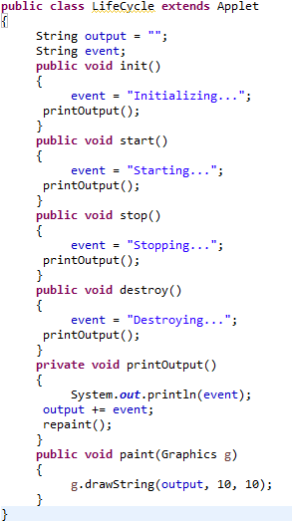
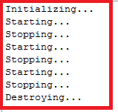
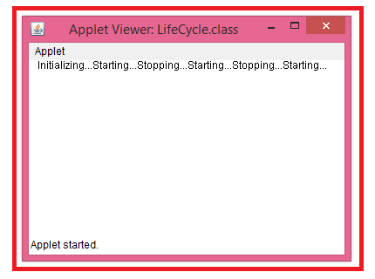
Applet Life Cycle

Slide 11
Applet Life Cycle
paint( )
Called each time your output must be redrawn.
In case like applet window may be minimized and restored.
Also called when applet begins the execution.
paint( ) method has one parameter of type Graphics. This parameter will contain the graphics context, which describes the graphics environment in which the applet is running.
This context is used whenever output of the applet is required.
update( )
Called when your applet has requested that a portion of its window be redrawn.
For example, redrawing the background over and over.
The default version of update( ) simply calls paint( ).
update( ) is used when repainting is performed.

Slide 12
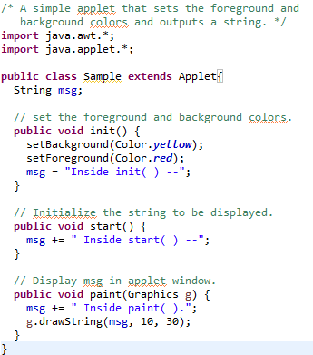
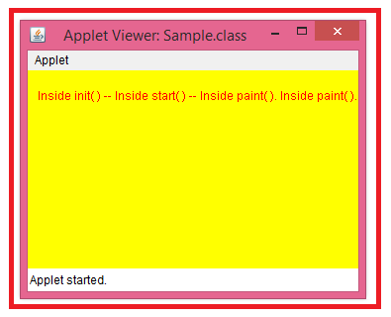
Applet display methods
void drawString(String message, int x, int y)
Here, message is the string to be output beginning at x,y.
void setBackground(Color newColor) – sets the background color
void setForeground(Color newColor) – sets the color of the font
Color getBackground( ) – returns the background color
Color getForeground( ) – returns the foreground color

Slide 13
repaint( )
How can the applet itself cause its window to be updated when its information changes?
For example, if the applet is displaying a moving banner, what mechanism does the applet use to update the window each time the banner scrolls?
Used when window is moved, or resized or unhidden.
Calls repaint( ) – defined by AWT. It causes the AWT run-time system to execute a call to applet’s update( ), which instead calls paint( ).
repaint() → update() → (usually calls) → paint()
void repaint(int left, int top, int width, int height)
void repaint(long maxDelay, int x, int y, int width, int height)

Slide 14
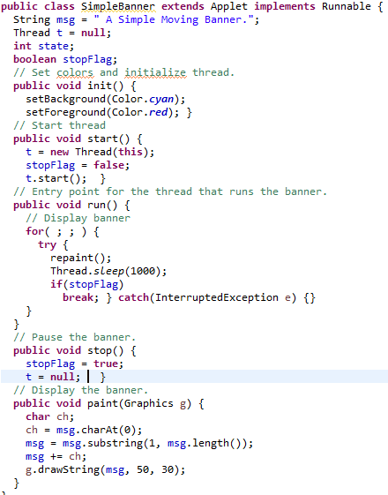
repaint( )

Slide 15
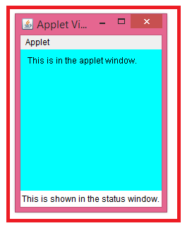
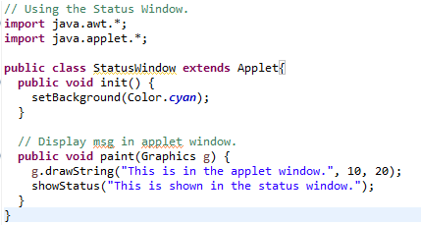
Using the Status Window
Good place to show the user feedback about what is occurring in the applet or report some errors.
Makes an excellent debugging aid, because it gives you an easy way to output information about your applet.

Slide 16
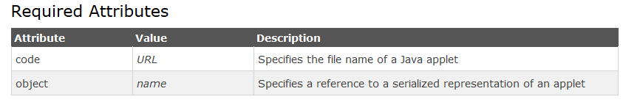
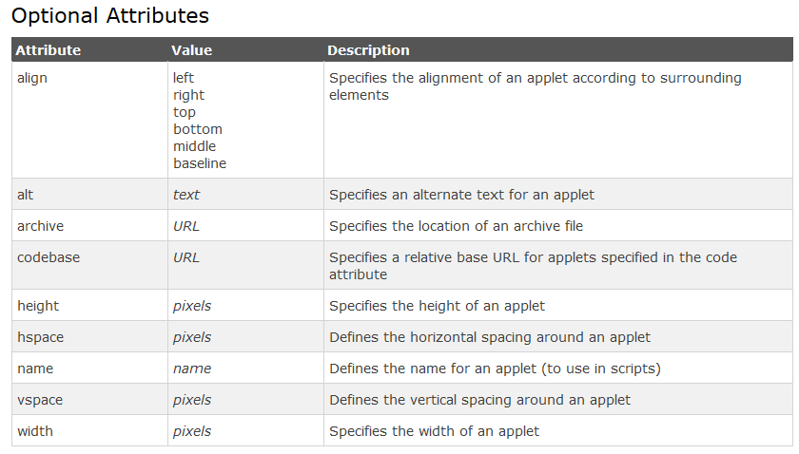
HTML Applet Tag

Slide 17
Passing Parameters to Applets
To retrieve a parameter, use the getParameter( ) method.
It returns the value of the specified parameter in the form of a String object.
Thus, for numeric and boolean values, conversion between string representations and internal formats is required.

Slide 18
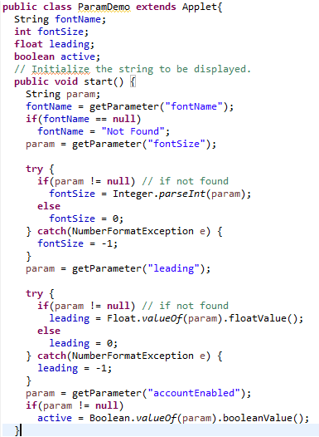
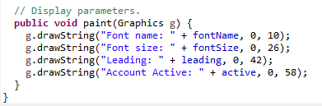
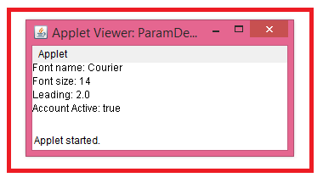
Passing Parameters to Applets

Slide 19
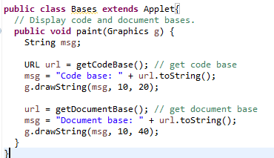
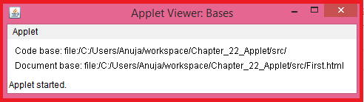
getDocumentBase( ) and getCodeBase( )
Used to explicitly load media and text.
Allows the applet to load data from the directory holding the HTML file that started the applet (document base).
The directory from which the applet’s class file was loaded (code base).

Slide 20
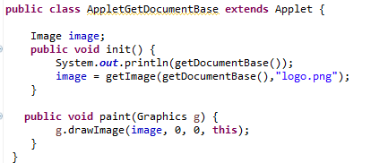
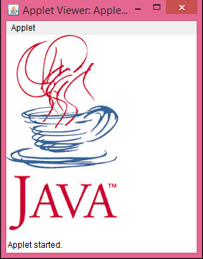
getDocumentBase( ) and getCodeBase( )

Slide 21
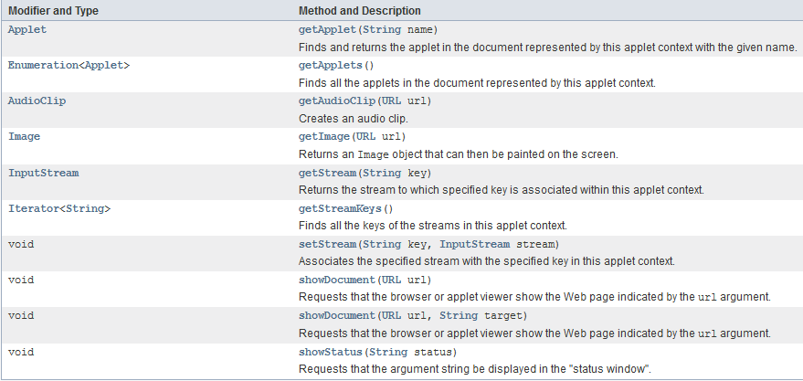
AppletContext
AppletContext
This interface corresponds to an applet’s environment: the document containing the applet and other applets in the same document.

Slide 22
showDocument( )
void showDocument(URL url)
Requests that the browser or applet viewer show the Web page indicated by the url argument.
The browser or applet viewer determines which window or frame to display the Web page.
This method may be ignored by applet contexts that are not browsers.
void showDocument(URL url, String target)
The target argument indicates in which HTML frame the document is to be displayed.
Target arguments are such as “_self”, “_parent”, “_top”, “_blank”, name.

Slide 23
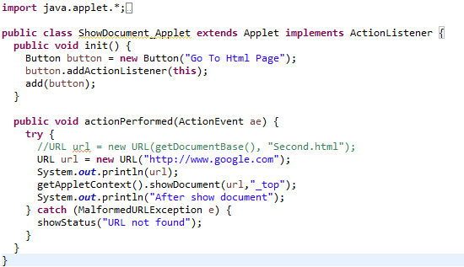
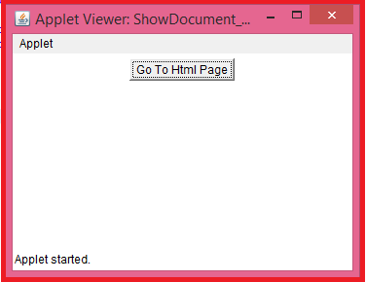
AppletContext and showDocument( )

Slide 24
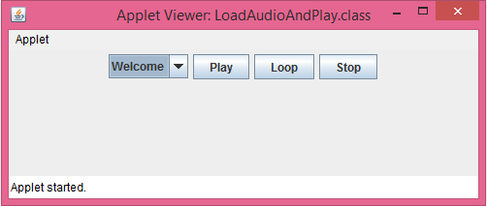
AudioClip Interface
The AudioClip interface defines these methods: play( ) (play a clip from the beginning), stop( ) (stop playing the clip), and loop( ) (play the loop continuously).
After you have loaded an audio clip using getAudioClip( ), you can use these methods to play it.
Refer to the program LoadAudioAndPlay.java

Slide 25
THANK YOU!!
ANY QUESTIONS??

